Slide 1
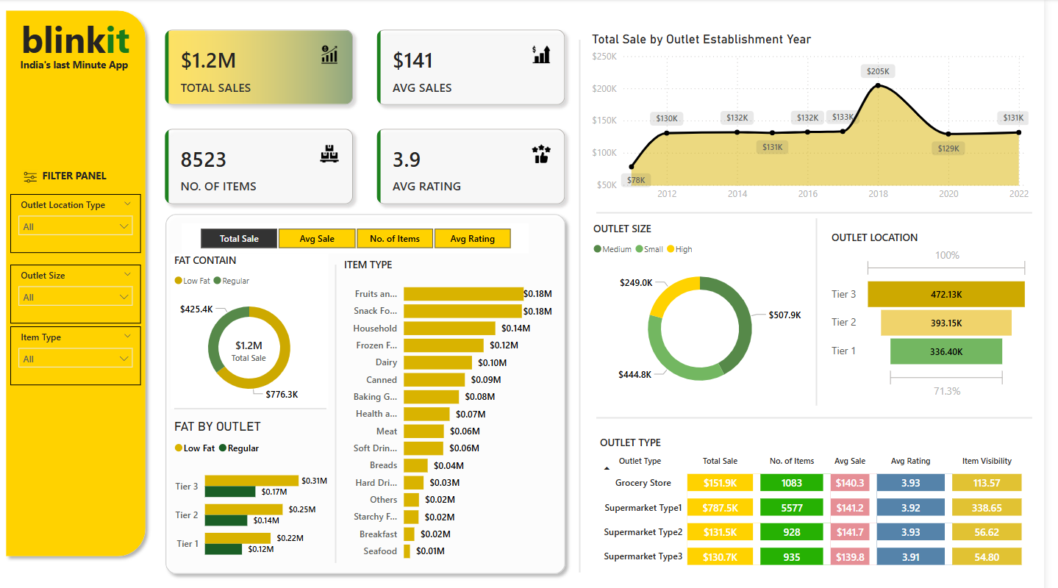

Slide 2

blinkit Analysis
STEPS IN PROJECT
Requirement Gathering / Business Requirements
Data Walk through
Data Connection
Data cleaning
Data modelling
Data Processing
DAX Calculations
Dashboard Lay outing
Charts Development and Formatting
Dashboard / Report Development
Insights Generation

Slide 3
blinkit Analysis
BUSINESS REQUIREMENT
To conduct a comprehensive analysis of Blinkit’s sales performance , customer satisfaction , and inventory distribution to identify insights and opportunities for optimization using various KPIs and visualizations in Power BI.
KPI’s Requirements
Total Sales : The overall revenue generated from all items sold.
Average Sales : The average revenue per sale.
Number of Items : The total count of different items sold
Average Rating : The average customer rating for items sold.

Slide 4
blinkit Analysis
BUSINESS REQUIREMENT
Chart’s Requirements
Total Sales by Fat Content:
Objective : Analyse the impact of fact content on total sales.
Additional KPI Metrics: Assess how other KPI’s (Average Sales , Number of items, Average Rating) vary with fat content.
Chart Type : Donut Chart.
Total Sales by Item:
Objective : Identify the performance of different item type in term of total sales.
Additional KPI Metrics: Assess how other KPI’s (Average Sales , Number of items, Average Rating) vary with fat content.
Chart Type : Bar Chart.
Fat Content by Outlet for Total Sales:
Objective : Compare total sales across different outlet segmented by fat content.
Additional KPI Metrics: Assess how other KPI’s (Average Sales , Number of items, Average Rating) vary with fat content.
Chart Type : Bar Chart.
Total Sales by OutletEstablishment:
Objective : Evaluate how the age or type of outlet establishment infliences total sales.
Chart Type : Line Chart.

Slide 5
blinkit Analysis
BUSINESS REQUIREMENT
Chart’s Requirements
Sales by Outlet Size:
Objective : Analyse the correlation between outlet size and total sales.
Chart Type : Donut / Pie Chart.
Sales by Outlet Location:
Objective : Assess the geographic distribution of sales across different location.
Chart Type : Funnel Chart.
All Metrics by Outlet Type:
Objective :Provide a comprehensive of all key metrics (Total Sales , Average sales , Number of Items , Average Rating) broken
Down by different outlet type.
Chart Type : Matrix Card.

Slide 6
THANK YOU

